Slide 1
18CSE751 – Introduction to Machine Learning Lecture 18: Learning with Trees
Dr.Vani Vasudevan
Professor –CSE, NMIT

Slide 2
Unit IV
Decision Trees : Learning with Trees, Using Decision Trees, Univariate Trees, Classification Trees, Regression Trees, Pruning, Rule Extraction from Trees, Learning Rules from Data, Multivariate Trees, ID3, Examples Support Vector Machines : Optimal Separation, Kernels, SVM Algorithm, Multiclass Classification, SVM Regression (T2-Chapter-9,13;T1-Chapters 8,12)

Slide 3
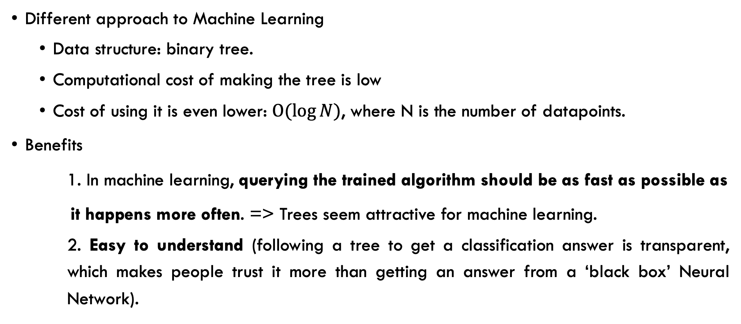
Learning with Trees
Different approach to Machine Learning
Data structure: binary tree.
Computational cost of making the tree is low
Cost of using it is even lower: $O(\log{N})$, where N is the number of datapoints.
Benefits
1. In machine learning, querying the trained algorithm should be as fast as possible as
it happens more often. => Trees seem attractive for machine learning.
2. Easy to understand (following a tree to get a classification answer is transparent, which makes people trust it more than getting an answer from a ‘black box’ Neural Network).

Slide 4
Learning with Trees…
Idea :
Break classification down into a set of choices about each feature ,
Starting at the root (base) of the tree and
Progressing down to the leaves, where the classification decision is received.
Turned into a set of if-then rules, suitable for use in a rule induction system.
Optimisation and search,
Decision trees use a greedy heuristic to perform search,
Evaluating the possible options at the current stage of learning and making the one that seems optimal at that point.
It works well most of the time.

Slide 5
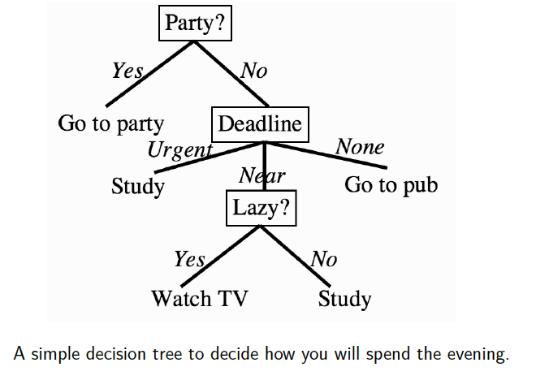
USING Decision TREE

Slide 6
CONSTRUCTING DECISION TREES
In the previous example, the three features:
Energy level,
Nearest deadline date, and
Party tonight?.
Based on these features, how to construct the tree?
Variants with the same principle:
Greedy approach - starting at the root, choosing the most informative feature at each step.
Common: quinlan’s ID3, Its extension C4.5, and CART.

Slide 7

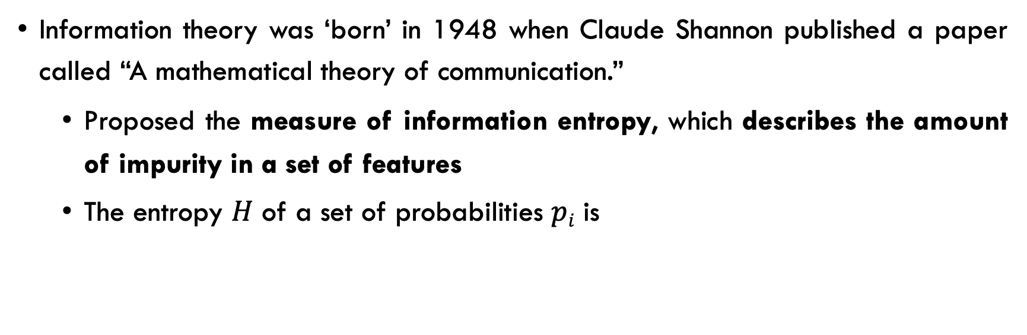
Entropy in Information Theory…
Information theory was ‘born’ in 1948 when Claude Shannon published a paper called “A mathematical theory of communication.”
Proposed the measure of information entropy, which describes the amount of impurity in a set of features
The entropy $H$ of a set of probabilities $pi$ is
Notes:
where the logarithm is base 2 because we are imagining that we encode everything using binary digits (bits), and we define 0 log 0 = 0.

Slide 8
Entropy in Information Theory…
If all the examples are positive, then NO extra information => the example will be positive. Thus, the entropy of that feature is 0.
If the feature separates the examples into 50% positive and 50% negative, then the amount of entropy is at a maximum, and knowing about that feature is very useful to us.
The basic concept is that it tells us how much extra information we would get from knowing the value of that feature.

Slide 9
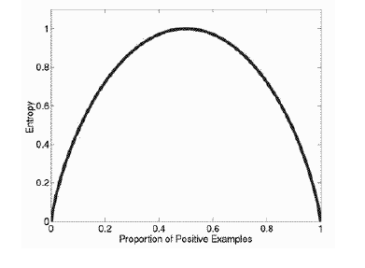
Entropy in Information Theory
A graph of entropy, detailing how much information is available from finding out another piece of information given what you already know.

Slide 10
Algorithm for Decision Tree Induction
Basic algorithm (a greedy algorithm)
Tree is constructed in a top-down recursive divide-and-conquer manner
At start, all the training examples are at the root
Attributes are categorical (if continuous-valued, they are discretized in advance)
Examples are partitioned recursively based on selected attributes
Test attributes are selected basis of a heuristic or statistical measure (e.g., Information gain)
Conditions for stopping partitioning
All samples for a given node belong to the same class
There are no remaining attributes for further partitioning—majority voting is employed for classifying the leaf
There are no samples left

Slide 11

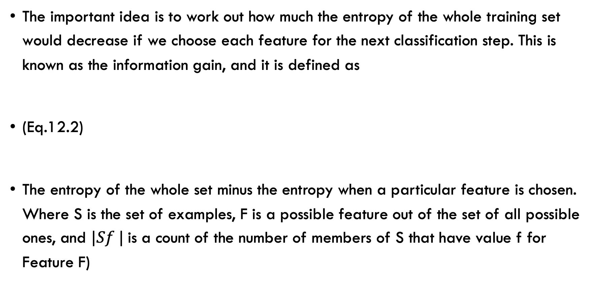
ID3…
The important idea is to work out how much the entropy of the whole training set would decrease if we choose each feature for the next classification step. This is known as the information gain, and it is defined as
(Eq.12.2)
The entropy of the whole set minus the entropy when a particular feature is chosen. Where S is the set of examples, F is a possible feature out of the set of all possible ones, and $|Sf |$is a count of the number of members of S that have value f for Feature F)

Slide 12
Attribute Selection Measure: Information Gain
(ID3/C4.5)
Select the attribute with the highest information gain
Let p_{i} be the probability that an arbitrary tuple in D belongs to class C_{i}, estimated by |C_{i, D}|/|D|
Expected information (entropy) needed to classify a tuple in D:
Information needed (after using A to split D into v partitions) to classify D:
Information gained by branching on attribute A
Notes:
I : the expected information needed to classify a given sample
E (entropy) : expected information based on the partitioning into subsets by A

Slide 13
Attribute Selection: Information Gain
Class P: buys_computer = “yes”
Class N: buys_computer = “no”
means “age <=30” has 5 out of 14 samples, with 2 yes’es and 3 no’s. Hence
Similarly,

Slide 14
Computing Information-Gain for Continuous-Valued Attributes
Let attribute A be a continuous-valued attribute
Must determine the best split point for A
Sort the value A in increasing order
Typically, the midpoint between each pair of adjacent values is considered as a possible split point
(A_{i}+a_{i+1})/2 is the midpoint between the values of a_{i} and a_{i+1}
The point with the minimum expected information requirement for A is selected as the split-point for A
Split:
D1 is the set of tuples in D satisfying A ≤ split-point, and D2 is the set of tuples in D satisfying A > split-point

Slide 15
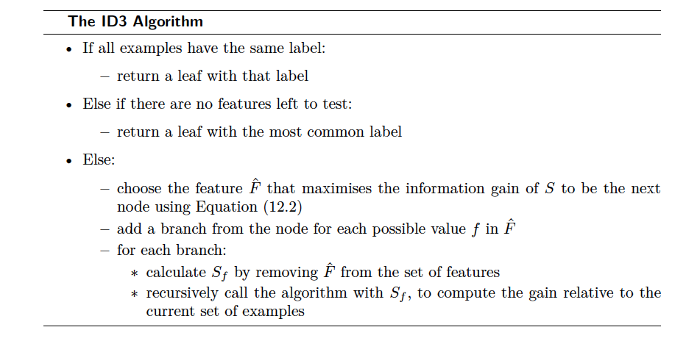
ID3
The ID3 algorithm computes the information gain for each feature and chooses the one that produces the highest value.

Slide 16
Classification & regression Tree (CART)…
Its another well-known tree-based algorithm
CART => name indicates that it can be used for both classification and regression.
Classification in CART uses a different information measure : Gini impurity
The ‘impurity’ in the name suggests that the aim of the decision tree is to have each leaf node represent a set of datapoints that are in the same class, so that there are no mismatches. This is known as purity.
If a leaf is pure then all the training data within it have just one class.

Slide 17
Measure of Impurity: GINI
Gini index for a given node t :
(NOTE: p( j | t) is the relative frequency of class j at node t).
Maximum (1 - 1/n_{c}) when records are equally distributed among all classes, implying least interesting information
Minimum (0.0) when all records belong to one class, implying most interesting information

Slide 18
Examples for computing GINI
P(C1) = 0/6 = 0 P(C2) = 6/6 = 1
Gini = 1 – P(C1)² – P(C2)² = 1 – 0 – 1 = 0
P(C1) = 1/6 P(C2) = 5/6
Gini = 1 – (1/6)² – (5/6)² = 0.278
P(C1) = 2/6 P(C2) = 4/6
Gini = 1 – (2/6)² – (4/6)² = 0.444

Slide 19
Splitting Based on GINI
Used in CART, SLIQ, SPRINT.
When a node p is split into k partitions (children), the quality of split is computed as,
Where, n_{i} = number of records at child i,
n = number of records at node p.

Slide 20
Binary Attributes: Computing GINI Index
Splits into two partitions
Effect of Weighing partitions:
Larger and Purer Partitions are sought for.
B?
Yes
No
Node N1
Node N2
Gini(N1) = 1 – (5/6)² – (2/6)² = 0.194
Gini(N2) = 1 – (1/6)² – (4/6)² = 0.528
Gini(Children) = 7/12 * 0.194 + 5/12 * 0.528 = 0.333

Slide 21
Categorical Attributes: Computing Gini Index
For each distinct value, gather counts for each class in the dataset
Use the count matrix to make decisions
Multi-way split
Two-way split
(find best partition of values)
Notes:
Gini(Sport)=1-POWER((2/3),2)-POWER((1/3),2) = 0.444
Gini(Family) =1-POWER((1/5),2)-POWER((4/5),2) = 0.32
Gini(Luxury) =1-POWER((1/2),2)-POWER((1/2),2)= 0.5
Gini(Car Type) =0.5*0.32+0.3*0.444+0.2*0.5 = 0.393

Slide 22
Continuous Attributes: Computing Gini Index
Use binary decisions based on one value
Several choices for the splitting value
Number of possible splitting values = number of distinct values
Each splitting value has a count matrix associated with it
Class counts in each of the partitions, A < v and A ≥ v
Simple method to choose best v
For each v, scan the database to gather count matrix and compute its Gini index
Computationally inefficient! Repetition of work.

Slide 23
Continuous Attributes: Computing Gini Index...
For efficient computation: for each attribute,
Sort the attribute on values
Linearly scan these values, each time updating the count matrix and computing Gini index
Choose the split position that has the least Gini index
Sorted Values
Split Positions

Slide 24
regression IN Tree
The new part about CART is its application in regression.
When outputs are continuous, a regression model is appropriate.
Use the sum-of-squares error.
To evaluate the choice of which feature to use next, find the value at which to split the dataset according to that feature.
Choose the split point for a given feature, by choosing it to minimise the sum-of-squares error.
Then, continue to use the algorithm for classification.

Slide 25
References
T1: Stephan Marsland, Machine Learning, An algorithmic Perspective, CRC Press Second Edition, 2015.
T2: Ethem Alpaydin, Introduction to Machine Learning, 2nd Ed., PHI Learning Pvt. Ltd., 2013
R1: Pang-Ning Tan, Vipin Kumar, Michael Steinbach: Introduction to Data Mining, Pearson, 2012.

